Slide 1
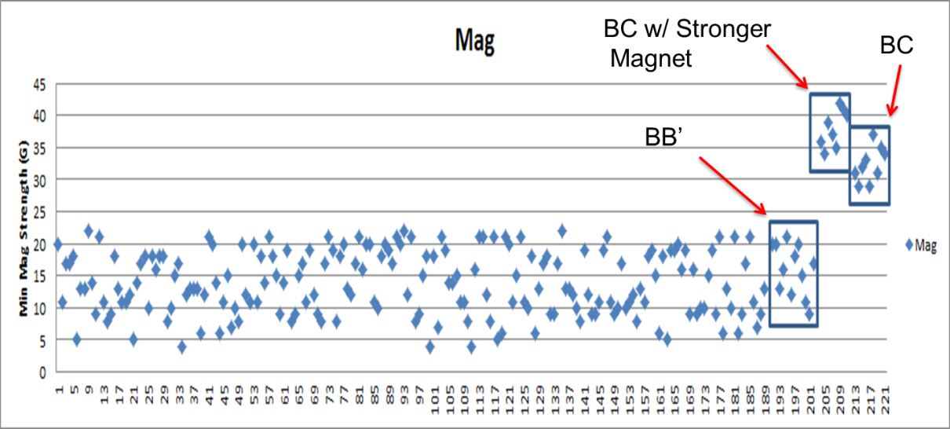
SGMW 200 Digital Position Sensor
Action Items:
Allegro BC Chip – Anticipated Larger Enhancement
30 pieces shipped to Saginaw for Evaluation …..
9 Samples tested with very positive results
Another 21 parts to be tested with Minimum Magnet Strength
Timing tight to meet future builds …. Team working to get into next Build
Software update (dll & software release) …. Averaging ….. Targeting next Build in April
Probe Housing Shift of 1.0 mm (Location of Hall to Magnet)
Doubtful for June SOP due to leadtime (12 weeks), bank builds, etc.
Stronger Magnets (Additional Testing Required)
Testing in Process to Understand Affect on Torque Sensor
100 Pieces available in Suzhou
Patent Search ---- Completed with no evident issues
In the chart below, the first ~190 points are from the sorting that was done in China (BB'). The first box are from the post DV testing (BB'). The second box is from the BC 1332s with the Max Baermann higher strength magnets (~50% increase) on the lower rotor assemblies. The third box is from the BC 1332s with the standard production lower rotor magnets.

